Slide 1
1.OA.1
Word problems
Addition/subtraction within 20
Notes:
Mathematically proficient students communicate precisely by engaging in discussion about their reasoning using appropriate mathematical language.
The terms students should learn to use with increasing precision are: (adding to, taking away, putting together, taking apart, comparing, unknown, sum, less than, equal to, minus, subtract, the same amount as).

Slide 2
1.OA.1 Standard
Use addition and subtraction within 20 to solve word problems involving situations of adding to, taking from, putting together, taking apart, and comparing, with unknowns in all positions, e.g., by using objects, drawings, and equations with a symbol for the unknown number to represent the problem.

Slide 3
Add To/Result Unknown
John saw 3 cars on the street. Soon, 4 more cars arrived. How many cars are now on the street?
3 + 4 = ?
Notes:
Add To/Result Unknown
3 + 4 = x
Addition within 10 includes the Add To situation with the Result Unknown
This problem gives the student a pictorial representation of the problem
Building on the addition and subtraction situations Add To/Take From and the Put Together/Take Apart action situation.

Slide 4
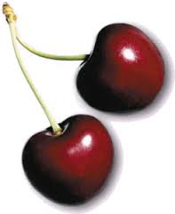
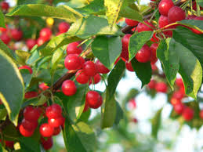
Add To/Change Unknown
Fred had seven cherries.
Then he picked some more.
Now he has nine.
How many did he pick?
a. 7
b. 9
c. 2
d. 3
Can you make a number sentence to show your answer?
Notes:
Add To/Change Unknown
7 + n = 9
Discuss other equations that can be made from this problem.
Can this be shown in bar/tape form?
Can this problem be changed to a subtraction problem?
Students can use drawing and manipulatives to solve this problem

Slide 5
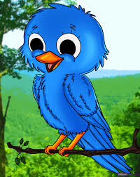
Add To/Start Unknown
Some birds were on the fence. Six birds joined them. Now there are 8 birds on the fence. How many birds were on the fence before?
Draw a picture.
Circle and label your answer.
Notes:
X + 6 = 8Add To
Discuss other equations that can be made from this problem. http://www.google.com/imgres?imgurl=http%3A%2F%2Fimgs.tuts.dragoart.com%2Fhow-to-draw-baby-birds_1_000000002312_5.jpg&imgrefurl=http%3A%2F%2Fwww.dragoart.com%2Ftuts%2F2312%2F1%2F1%2Fhow-to-draw-baby-birds.htm&h=1494&w=1188&tbnid=Yf2O6fnCwdfWAM%3A&zoom=1&docid=jqGFQ2TAWHY2VM&ei=xZ9iVJHqI6zHsQSAsoCoCQ&tbm=isch&ved=0CFQQMygbMBs&iact=rc&uact=3&dur=577&page=2&start=15&ndsp=20
Can this be shown in bar/tape form? Does the fence lend itself to a representation of the bar/tape representation? Include this in your discussion.
Can this problem be changed to a subtraction problem?

Slide 6
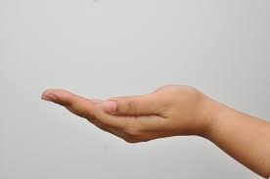
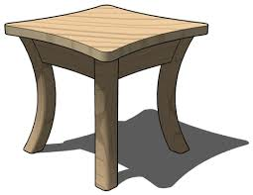
Seven dimes are on the table, two more
dimes are in Pat’s hand.
+
7 + 2 = ?
How many dimes are there altogether?
Notes:
7 + 2 = ?
Discuss other equations that can be made from this problem.
Can this be shown in bar/tape form?
Can this problem be changed to a subtraction problem?

Slide 7
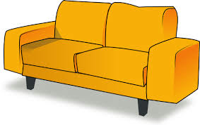
Ava had 7 marbles. She found some more marbles under the couch. Now Ava has 9 marbles. How many marbles did Ava find under the couch?
7 + ? = 9
Notes:
Use objects, drawings, and equations with a symbol for the unknown number to represent the problem
Can this be made into a subtraction problem?
Have a discussion on what is “How many more” and “ How many less” means
Use a ten frame, drawings or manipulatives

Slide 8
Finn found a variety of shells as he was walking on the beach in the morning. In the afternoon Finn found two shells. When Finn left the beach he had 10 shells. How many shells did Finn find in the morning?
? + 2 = 10
Notes:
Students develop strategies for adding and subtracting whole numbers based on their prior work with small numbers.
Use a ten frame, manipulatives or drawings
Can a subtraction problem be made from this problem?
Students must think about a quantity that is not physically present and must conceptualize that amount

Slide 9
Hannah the Hen had 5 chicks. Then 3 chicks hatched. How many chicks does Hannah the Hen have now?
5 + 3 = ?
Notes:
Students can extend the sophistication of the methods they used in Kindergarten to add within a larger range.
Students can use the Counting on Method
Can students use Fact Families to answer the question?

Slide 10
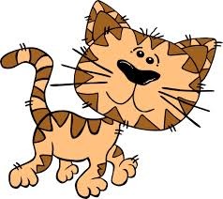
Charlotte counted 19 pets in the
Animal Crackers Pet Shop.
She saw 16 puppies and and 3 kittens. How many rabbits did she see?
Notes:
Working backwards from the 19 pets, students may use different methods to determine the number of rabbits.
Students can use counters, base ten blocks, ten frame, drawings
Compare a variety of solution strategies
19-3=

Slide 11
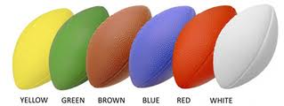
Kevin has a lot of footballs. He received 4 footballs for his birthday. Now he has 10 footballs. How many footballs did Kevin have before his birthday?
4 + ? = 10
Notes:
Use objects, drawings, and equations with a symbol for the unknown number to represent the problem
Can this be made into a subtraction problem?
Have a discussion on what is “How many more” and “ How many less” means
Use a ten frame, drawings or manipulatives

Slide 12
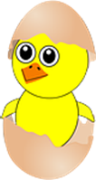
Lola the Hen had 15 chicks. Then 3 chicks hatched. How many chicks does Hannah the Hen have now?
15 + 3 = ?
Notes:
Students can extend the sophistication of the methods they used in Kindergarten to add within a larger range.
Students can use the Counting on Method
Can students use Fact Families to answer the question?
Use ten frame

