Slide 1
1.oA.3
Operations & Algebraic Thinking

Slide 2
1.OA.3 Standard
Apply properties of operations as strategies to add and subtract.
Examples:
If 6 + 3 = 9 is known, then 3 + 6 = 9 is also known. (Commutative property of addition)
To add 6 + 3 + 4, the second two numbers can be added to make a seven, so 6 + 3 + 4 = 6 + 7 = 13. (Associative property of addition)

Slide 3
Problem 1:
Use the digits in the box to write 4 different equations.
__________ + __________ = __________
__________ + __________ = __________
__________ − __________ = __________
__________ − __________ = __________
7, 3, 10

Slide 4
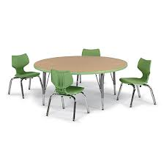
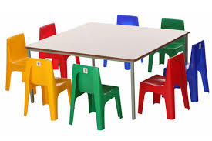
Problem 2:
Use objects or drawings to represent the problems below:
There were 9 students at the reading table. 9 of the students at the reading table were boys. How many girls were at the reading table?
12 students sat at the reading table. There were 0 boys at the table. How many girls were at the reading table?

Slide 5
Pr0blem 3:
Fill in the blanks:
(4+6)+10 = 4+(6+10)
____ +10 = 4+ ____
____ = ____

Slide 6
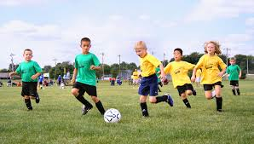
Problem 4:
There are 4 boys and 5 girls on Laticia’s soccer team and there are 5 boys and 4 girls on her brother’s team.
Laticia said that she knows that there is the same number of players on both teams because 4+5 and 5+4 are the same amount.
Do you agree or disagree with Laticia? Explain why.

Slide 7
Pr0blem 5:
What are the missing numbers?
7 + 6 + 3 = 10 +
8 + 4 + 8 = 16 +

Slide 8
Pr0blem 6:
Choose 3 addends that total 13?
13 = ____ + ____ +____
13 = ____ + ____ +____
7
10
2
4
3
6
1

Slide 9
Problem 7:
Max solved the following problem: 5 + 2 + 3 = 10.
First, he added 5 + 2 and got 7.
Then, he counted up 3 more and got an answer of 10.
Show how you would solve 5 + 2 + 3 a different way.

Slide 10
Problem 8:
Kala is thinking of a two numbers.
These two numbers add up to 9.
What could these numbers be?

Slide 11
Pr0blem 9:
Write 4 equations about the dominos?

