Slide 1
5.G.3: Shared Attributes of 2-D Figures
Understand that attributes belonging to a category of two-dimensional figures also belong to all subcategories of that category. For example, all rectangles have four right angles and squares are rectangles, so all squares have four right angles.

Slide 2
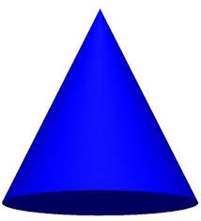
Help Ali Find Shapes!

Slide 3
Ali says this is a quadrilateral and a parallelogram. Debbie says it’s a rectangle. Mike thinks it’s a rhombus. Who is right?
Notes:
Quadrilateral, parallelogram and rectangle.

Slide 4
Look at the Hexagon said Ali! Ray said it is a polygon. Lauren said it is a parallelogram. Who is right?
Notes:
Hexagon

Slide 5
Ali loves cookies in the shape of trapezoids. Mommy said the cookie looks like a rhombus. Daddy said it’s a parallelogram. Who is right?
Notes:
Trapezoid

Slide 6
Is Ali holding a diamond, kite, quadrilateral, or square?
Notes:
quadrilateral

Slide 7
Ali picked a piece of pizza that looks like an obtuse triangle. Aunt Debbie said it is an acute triangle. The pizza delivery man said it is an equilateral triangle. Who is right?
Notes:
acute triangle

Slide 8
Ali says that this is a rectangle, a parallelogram, and a quadrilateral. Is she right? Explain your reasoning.

Slide 9
Is this an isosceles, equilateral or scalene triangle. Could it be acute too?
3
3
3
Notes:
equilateral

Slide 10
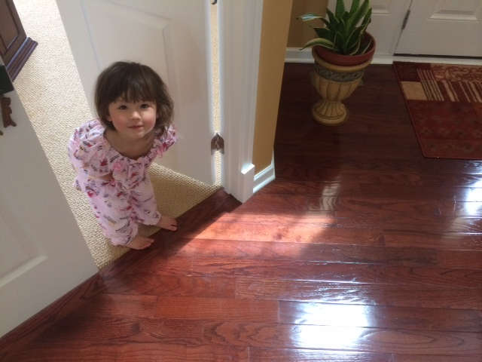
Ali says this circle is a polygon. Do you agree or disagree?

Slide 11
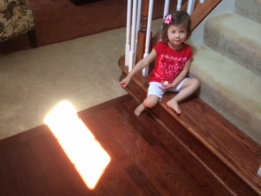
Ali wants to know all the names of this shape. Can you help her?

Slide 12
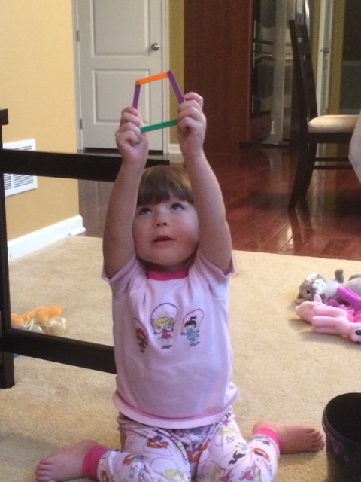
Ali said this is a trapezoid and a quadrilateral. Do you agree?

Slide 13
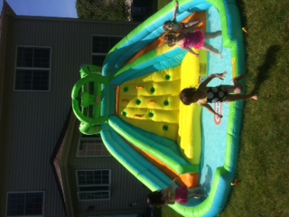
What is the shape of Ali’s water slide?
Notes:
quadrilateral

