Slide 1
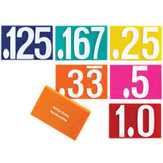
5.NBT.3
5.NBT.3a: Read and Write Decimals: Read and write decimals to thousandths using base-ten numerals, number names, and expanded form, e.g., 347.392 = 3 × 100 + 4 × 10 + 7 × 1 + 3 × (1/10) + 9 × (1/100) + 2 × (1/1000).
5.NBT.3b — Compare Decimals: Compare two decimals to thousandths based on meanings of the digits in each place, using >, =, and < symbols to record the results of comparisons.

Slide 2
Bridgette is thinking of the number 27.077. Decide which of the following have the same value as 27.077 and discuss your reasoning.
Twenty seven and seventy seven thousandths.
27 + 0.077
(2 x 10) + (7 x 1) + (0 x 1/10) + (7 x 1/100) + (0 x 1/1000)
Twenty seven and seventy thousandths
27077 thousandths
27 ones + 77 hundredths

Slide 3
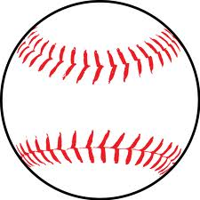
Maeve threw a ball 4.586 yards. Decide which of the following have the same value as 4.586. Discuss your reasoning.
Four and five hundred eighty six thousandths
4 + 0.500 + 0.080 + 0.006
4586 hundredths
(4 x 1) + (50 x 1/100) + (8 x 1/100) + (6 x 100)
4 ones + 5 tenths + 8 hundredths + 6 thousandths
Four and five hundred eighty six hundredths

Slide 4
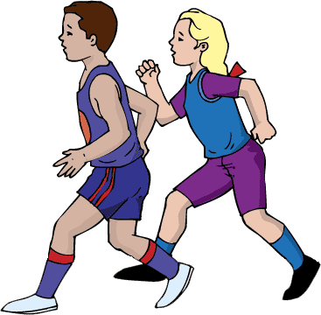
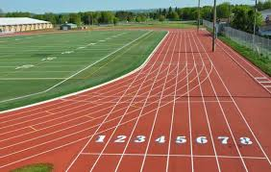
Yaman ran 100 meters in 15.892 seconds. Decide which of the following have the same value as 15.892. Discuss your reasoning.
Fifteen and eight hundred ninety two thousands
15,892 tenths
Fifteen and eighty hundred ninety two hundredths
15,892 hundredths
(15 x 1) + (8 x 1/10) + (9 x 1/100) + (2 x 1/1000)
1 ten + 5 ones + 8 hundredths + 9 tenths + 2 thousandths

Slide 5
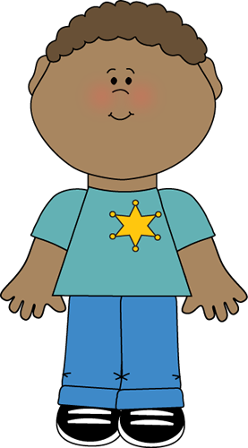
Fred is thinking of the number 4.022 in his head. Decide which of the following have the same value as 4.022. Discuss your reasoning.
Four and twenty-two hundredths
(4 x 1) + (2 x 1/100) + (2 x 1/1000)
4022 hundredths
4 ones + 2 tenths + 2 thousandths
Four and twenty-two thousandths
4022 thousandths

Slide 6
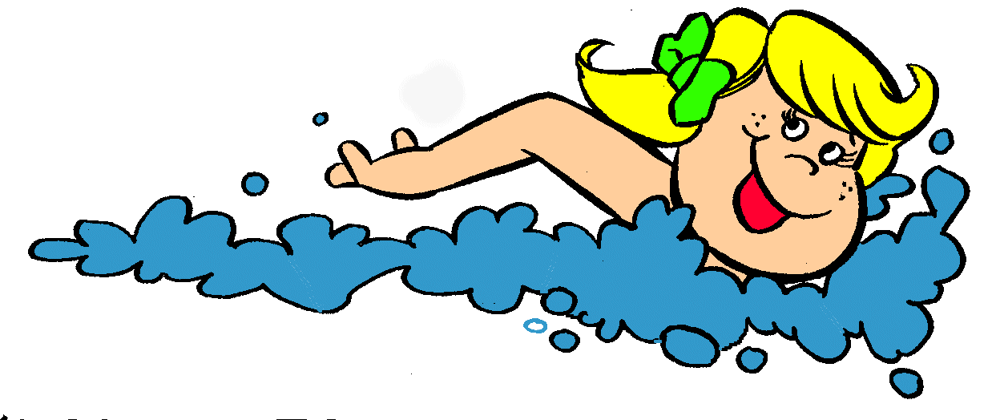
Foxtrot swam 50 meters in 27.017 seconds. Decide which of the following have the same value as 27.017. Discuss your reasoning.
Twenty-seven and seventeen thousandths
27 + 0.017
27 ones + 17 hundredths
27,017 hundredths
(2 x 10) + (7 x 1) + (1 x 1/100) + (7 x 1/1000)
Twenty-seven and one seventeenth

Slide 7
What number are you thinking of ?
Can you represent it correctly 4 different ways?

