Slide 1
Multiplying Fractions
2 ⅗ feet
3 ⅓ feet
What is the area? Show your strategy.

Slide 2
5.NF.4 Standards
5.NF.4a — Multiply Fractions and Interpret Products: Interpret the product (a/b) × q as a parts of a partition of q into b equal parts; equivalently, as the result of a sequence of operations a × q ÷ b. For example, use a visual fraction model to show (2/3) × 4 = 8/3, and create a story context for this equation. Do the same with (2/3) × (4/5) = 8/15. (In general, (a/b) × (c/d) = ac/bd.)
5.NF.4b — Area with Fractional Side Lengths: Find the area of a rectangle with fractional side lengths by tiling it with unit squares of the appropriate unit fraction side lengths, and show that the area is the same as would be found by multiplying the side lengths. Multiply fractional side lengths to find areas of rectangles, and represent fraction products as rectangular areas.

Slide 3
Tyrone created a poster for art class. His poster was a square and it’s sides were all 1 ¾ ft. What is the area of Tyrone’s poster in square feet?
Macy’s poster has the same area as Tyrone’s poster, but it is a rectangle. What could be the dimensions of Macy’s poster in feet?

Slide 4
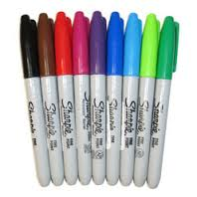
Ms. Chandra shared 12 markers among her four students:
Diamond received 1/3 of the markers.
Gail received 1/4 of the markers.
Tamera received more than 1 marker.
Josh received more markers than Tamera.
What fraction of the total number of markers did Tamera and Josh each receive? Explain your answer.

Slide 5
Todd found ⅝ of a Pie left over in the refrigerator. He wants to eat ½ of the remaining pie .
How much of the original pie does Todd want to eat?

Slide 6
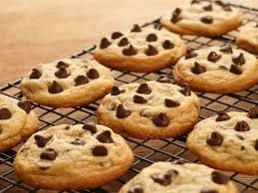
Mrs. Smith baked 3 dozen cookies. Two-thirds of them were chocolate chip.
How many oatmeal cookies did Mrs. Smith bake?

Slide 7
Mixed Numbers
Ruby’s mom bought a table that was 8 ft by 3 ¾ ft. Ruby wants to cover it in paper so she can paint. How much paper will she need?
8 x 3 ¾
8 x 3 = 24
24 + 6 = 30 sq ft

Slide 8
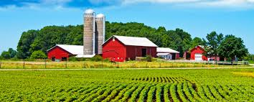
What’s the length?
The area of George’s farm is 1 ¾ square miles. Its width is ½ square miles. What is it’s length?
A = 1 ¾
Missing Factor Model
½ x ___ = 1 ¾
1/2

Slide 9
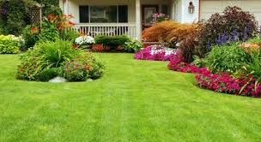
What’s the length?
Mr. Brown’s yard has an area of 1 ¼ square acres. Its width is ¼ acre. What is it’s length?
A = 1 ¼
Missing Factor Model
¼ x ___ = 1 ¼
1/4

Slide 10
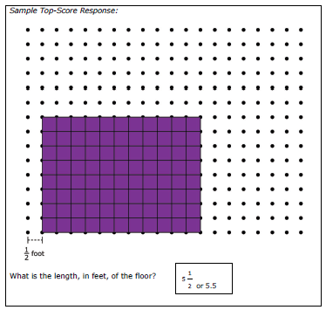
Tina wants a rug under her bed. The rug has a width of 4 ft and covers an area of 22 sq ft area.
What is the length of the rug?
Using dot paper model the rug that Tina is using in her room.

Slide 11
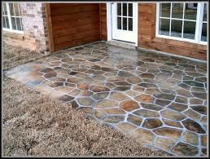
Daisy is installing a small patio in her back yard. She is using square stones for her patio.
The length of the sides of the square stone are ½ feet.
The area of the patio is 18 square feet.
The width of the patio is 4½ feet.
What is the length of the patio?
Using dot paper model draw the rectangular patio that Daisy is installing.
. . . . . . . . . . . . . . .
. . . . . . . . . . . . . . .
. . . . . . . . . . . . . . .
. . . . . . . . . . . . . . .
. . . . . . . . . . . . . . .
. . . . . . . . . . . . . . .
. . . . . . . . . . . . . . .
. . . . . . . . . . . . . . .
. . . . . . . . . . . . . . .
. . . . . . . . . . . . . . .
. . . . . . . . . . . . . . .
. . . . . . . . . . . . . . .
. . . . . . . . . . . . . . .
. . . . . . . . . . . . . . .
. . . . . . . . . . . . . . .
. .
½ foot

