Slide 1
Analyze, compare, create, and compose shapes
K.G.4 Analyze and compare two- and three-dimensional shapes, in different sizes and orientations, using informal language to describe their similarities, differences, parts (e.g., number of sides and vertices/”corners”) and other attributes (e.g., having sides of equal lengths).

Slide 2
Name the Shape
Can you name each shape?
What do they have in common?
What are some differences?
Notes:
Good “Turn and talk to your partner”.

Slide 3
What do you know about this shape?
What Shape is this?

Slide 4
What do you know about this shape?
What shape are these?

Slide 5
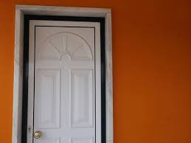
What do you know about this shape?
What shape do you see?

Slide 6
What do you know about this shape?
What shape do you see?

