Slide 1
K.CC.6
Comparing Numbers
Notes:
If one student provides an answer it is important for the teacher to continue the discussion on this problem by prompting students to see what other ways they can answer it. For example: if a slide says compare the numbers 2 and 3. One student may say the 2 is less than 3 and provide a strategy to prove it. Another student may same the same thing but use a different strategy. But also what we want to hear is a student say 3 is greater than 2 and provide proof based on a strategy. It is up to the teacher to facilitate this in the discussion thus providing students the opportunity to see the relationship in comparisons.

Slide 2
Which is greater?
6
5
Notes:
If one student provides an answer it is important for the teacher to continue the discussion on this problem by prompting students to see what other ways they can answer it. For example: if a slide says compare the numbers 2 and 3. One student may say the 2 is less than 3 and provide a strategy to prove it. Another student may same the same thing but use a different strategy. But also what we want to hear is a student say 3 is greater than 2 and provide proof based on a strategy. It is up to the teacher to facilitate this in the discussion thus providing students the opportunity to see the relationship in comparisons.

Slide 3
Which is greater?
8
9
Notes:
If one student provides an answer it is important for the teacher to continue the discussion on this problem by prompting students to see what other ways they can answer it. For example: if a slide says compare the numbers 2 and 3. One student may say the 2 is less than 3 and provide a strategy to prove it. Another student may same the same thing but use a different strategy. But also what we want to hear is a student say 3 is greater than 2 and provide proof based on a strategy. It is up to the teacher to facilitate this in the discussion thus providing students the opportunity to see the relationship in comparisons. Does the size of the shapes make this more difficult?

Slide 4


Which is greater?
Notes:
If one student provides an answer it is important for the teacher to continue the discussion on this problem by prompting students to see what other ways they can answer it. For example: if a slide says compare the numbers 2 and 3. One student may say the 2 is less than 3 and provide a strategy to prove it. Another student may same the same thing but use a different strategy. But also what we want to hear is a student say 3 is greater than 2 and provide proof based on a strategy. It is up to the teacher to facilitate this in the discussion thus providing students the opportunity to see the relationship in comparisons.

Slide 5


Which is fewer?
4
3
Notes:
If one student provides an answer it is important for the teacher to continue the discussion on this problem by prompting students to see what other ways they can answer it. For example: if a slide says compare the numbers 2 and 3. One student may say the 2 is less than 3 and provide a strategy to prove it. Another student may same the same thing but use a different strategy. But also what we want to hear is a student say 3 is greater than 2 and provide proof based on a strategy. It is up to the teacher to facilitate this in the discussion thus providing students the opportunity to see the relationship in comparisons.

Slide 6


Which is fewer?
5 hands
6 pencils
Notes:
Hands or colored pencils?
If one student provides an answer it is important for the teacher to continue the discussion on this problem by prompting students to see what other ways they can answer it. For example: if a slide says compare the numbers 2 and 3. One student may say the 2 is less than 3 and provide a strategy to prove it. Another student may same the same thing but use a different strategy. But also what we want to hear is a student say 3 is greater than 2 and provide proof based on a strategy. It is up to the teacher to facilitate this in the discussion thus providing students the opportunity to see the relationship in comparisons.

Slide 7


Which is fewer?
Notes:
If one student provides an answer it is important for the teacher to continue the discussion on this problem by prompting students to see what other ways they can answer it. For example: if a slide says compare the numbers 2 and 3. One student may say the 2 is less than 3 and provide a strategy to prove it. Another student may same the same thing but use a different strategy. But also what we want to hear is a student say 3 is greater than 2 and provide proof based on a strategy. It is up to the teacher to facilitate this in the discussion thus providing students the opportunity to see the relationship in comparisons.

Slide 8
Compare the number of objects
8
7
Notes:
If one student provides an answer it is important for the teacher to continue the discussion on this problem by prompting students to see what other ways they can answer it. For example: if a slide says compare the numbers 2 and 3. One student may say the 2 is less than 3 and provide a strategy to prove it. Another student may same the same thing but use a different strategy. But also what we want to hear is a student say 3 is greater than 2 and provide proof based on a strategy. It is up to the teacher to facilitate this in the discussion thus providing students the opportunity to see the relationship in comparisons.

Slide 9
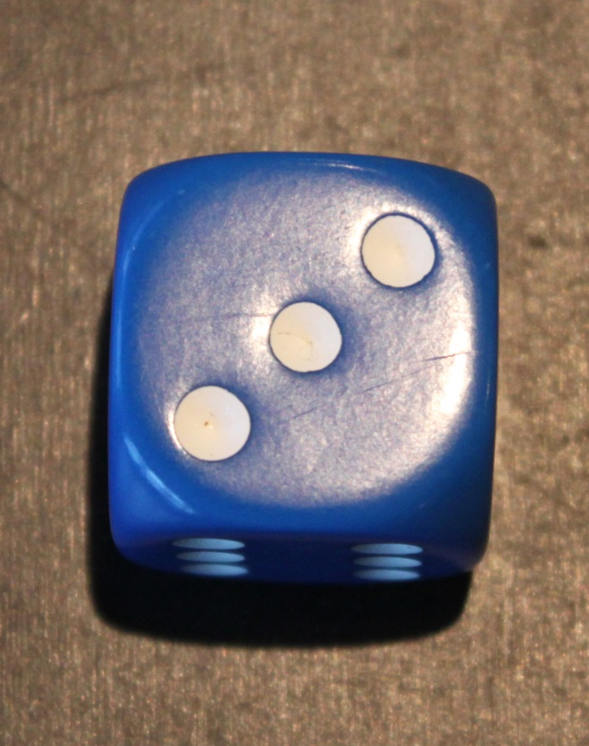
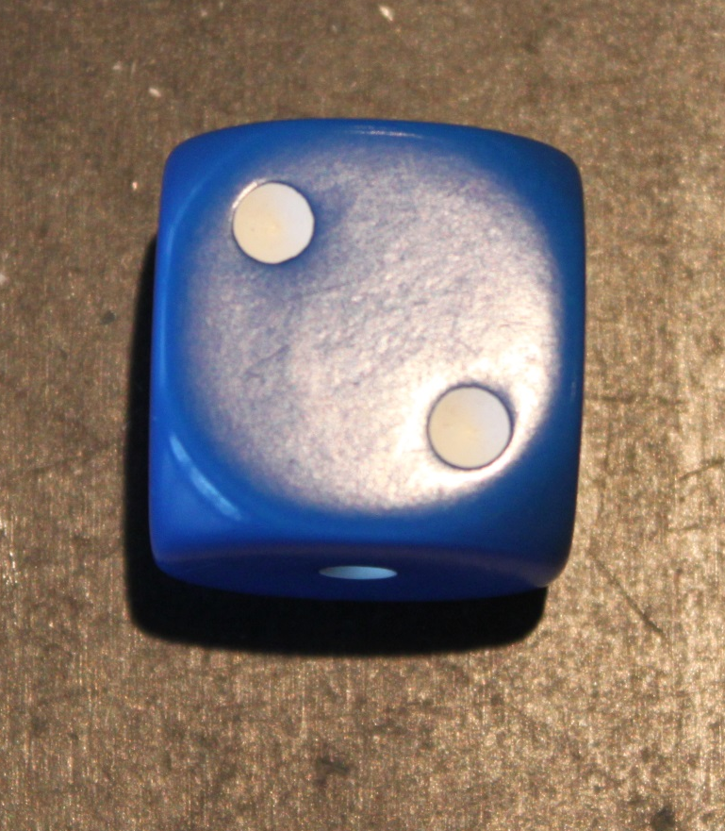
Compare the number of objects
Notes:
If one student provides an answer it is important for the teacher to continue the discussion on this problem by prompting students to see what other ways they can answer it. For example: if a slide says compare the numbers 2 and 3. One student may say the 2 is less than 3 and provide a strategy to prove it. Another student may same the same thing but use a different strategy. But also what we want to hear is a student say 3 is greater than 2 and provide proof based on a strategy. It is up to the teacher to facilitate this in the discussion thus providing students the opportunity to see the relationship in comparisons.

Slide 10


Compare the number of objects
Notes:
If one student provides an answer it is important for the teacher to continue the discussion on this problem by prompting students to see what other ways they can answer it. For example: if a slide says compare the numbers 2 and 3. One student may say the 2 is less than 3 and provide a strategy to prove it. Another student may same the same thing but use a different strategy. But also what we want to hear is a student say 3 is greater than 2 and provide proof based on a strategy. It is up to the teacher to facilitate this in the discussion thus providing students the opportunity to see the relationship in comparisons.

Slide 11
Compare the number of objects
Notes:
If one student provides an answer it is important for the teacher to continue the discussion on this problem by prompting students to see what other ways they can answer it. For example: if a slide says compare the numbers 2 and 3. One student may say the 2 is less than 3 and provide a strategy to prove it. Another student may same the same thing but use a different strategy. But also what we want to hear is a student say 3 is greater than 2 and provide proof based on a strategy. It is up to the teacher to facilitate this in the discussion thus providing students the opportunity to see the relationship in comparisons.

Slide 12
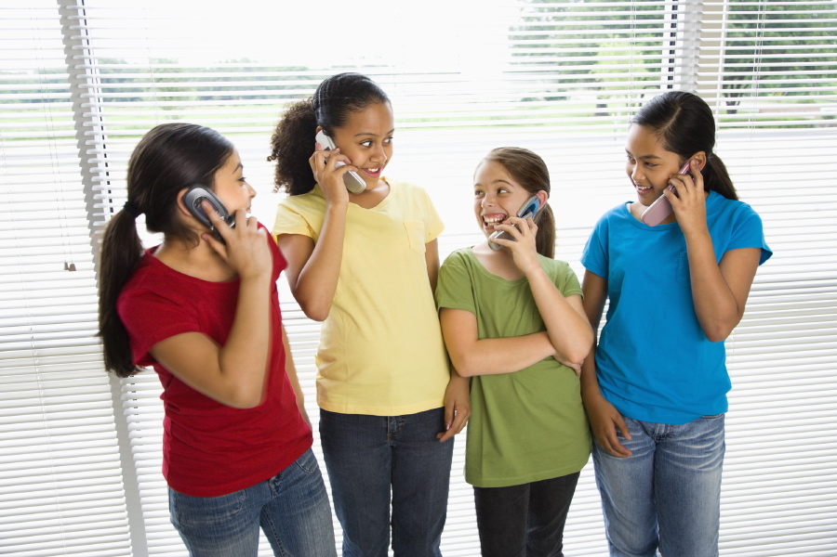
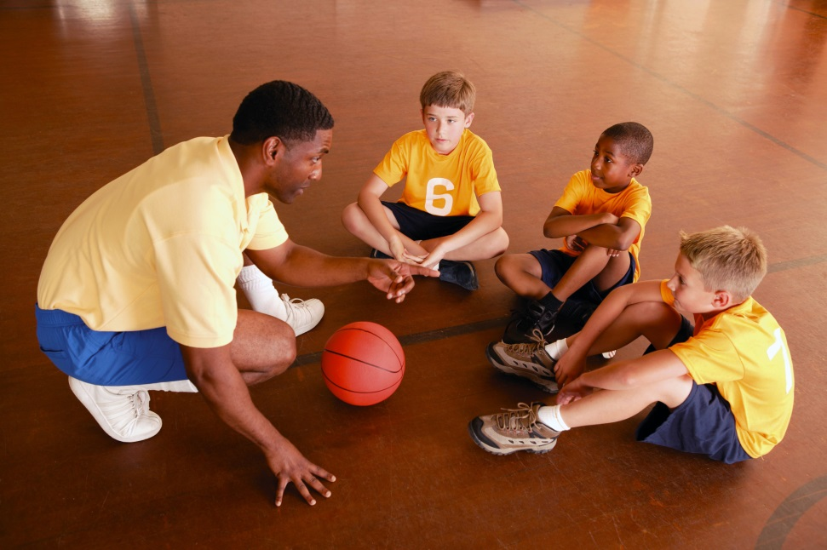
Compare the number of people
Notes:
If one student provides an answer it is important for the teacher to continue the discussion on this problem by prompting students to see what other ways they can answer it. For example: if a slide says compare the numbers 2 and 3. One student may say the 2 is less than 3 and provide a strategy to prove it. Another student may same the same thing but use a different strategy. But also what we want to hear is a student say 3 is greater than 2 and provide proof based on a strategy. It is up to the teacher to facilitate this in the discussion thus providing students the opportunity to see the relationship in comparisons.

Slide 13

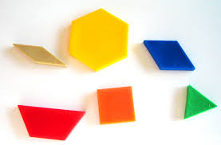
Compare the number of objects
Notes:
If one student provides an answer it is important for the teacher to continue the discussion on this problem by prompting students to see what other ways they can answer it. For example: if a slide says compare the numbers 2 and 3. One student may say the 2 is less than 3 and provide a strategy to prove it. Another student may same the same thing but use a different strategy. But also what we want to hear is a student say 3 is greater than 2 and provide proof based on a strategy. It is up to the teacher to facilitate this in the discussion thus providing students the opportunity to see the relationship in comparisons.

